Slide 1
Diffraction & Polarization
Presentation by
Dr. B. Dhana Lakshmi , M.Sc, Ph.D
Associate Professor in Physics
VIIT (A), Duvvada

Slide 2
Course Outcome:
Splitting of white light into constituent colours
Working details of Telescope and microscope
Optical activity of certain materials
Construction and working details of interferometer and polarimeter
Activity:
Estimation of wavelength of a monochromatic light from various sources

Slide 3
DIFFRACTION
Syllabus:
Fraunhofer diffraction at single slit cases
Circular aperture (Qualitative treatment only)
Grating equation
Resolving power of a grating, Telescope and Microscope

Slide 4
DIFFRACTION
Syllabus:
Fraunhofer diffraction at single slit cases
Circular aperture (Qualitative treatment only)
Grating equation
Resolving power of a grating, Telescope and Microscope

Slide 5
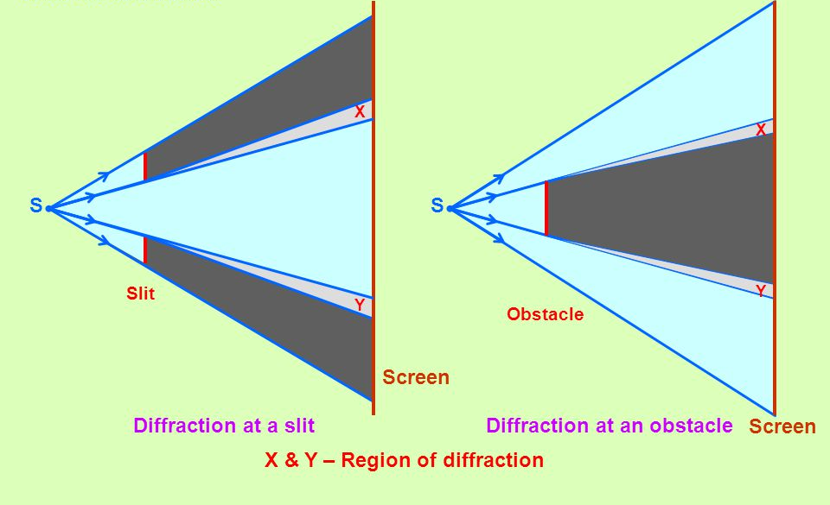
Introduction to diffraction
Definition:
The bending of the light wave around the corners of obstacles and the spreading of light waves into geometrical shadow of an obstacle is called diffraction

Slide 6
Differences between interference and diffraction
Interference | Diffraction
Two separate wave fronts originating from two coherent sources produce interference. | Secondary wavelets originating from different parts of the same wave front constitute diffraction.
The fringe width may or may not be equal | The fringe width of various fringes are never equal
All the bright fringes have same intensity | The bright fringes are of varying intensity
The region of minimum intensity is perfectly dark | The regions of minimum intensity are not perfectly dark

Slide 7
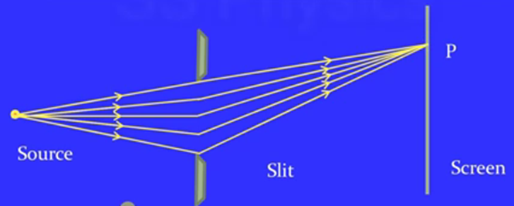
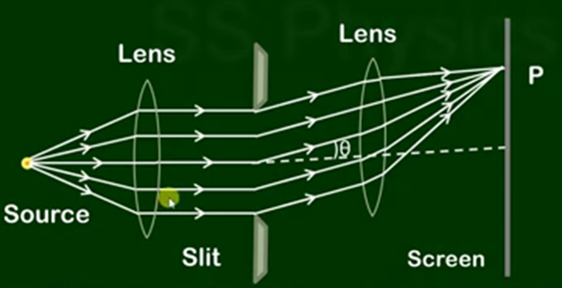
Fresnel diffraction | Fraunhofer diffraction
A point source or illuminated narrow slit is used | An extended source at infinite distance is used
The source and screen are placed at finite distance from the obstacle for producing diffraction pattern | The source and screen are placed at infinite distance from the obstacle
No lenses are used to focus the rays | Converging lens is used to focus the parallel rays
Wave front is spherical or cylindrical | Wavefront is a plane wave front
The centre of diffraction pattern may be dark or bright depending upon the number of Fresnel zones | The centre of diffraction pattern is always bright for all paths parallel to the axis of the length
Mathematical investigations are complicated | Mathematical investigations are easy

Slide 8
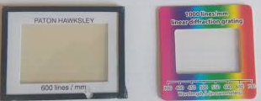
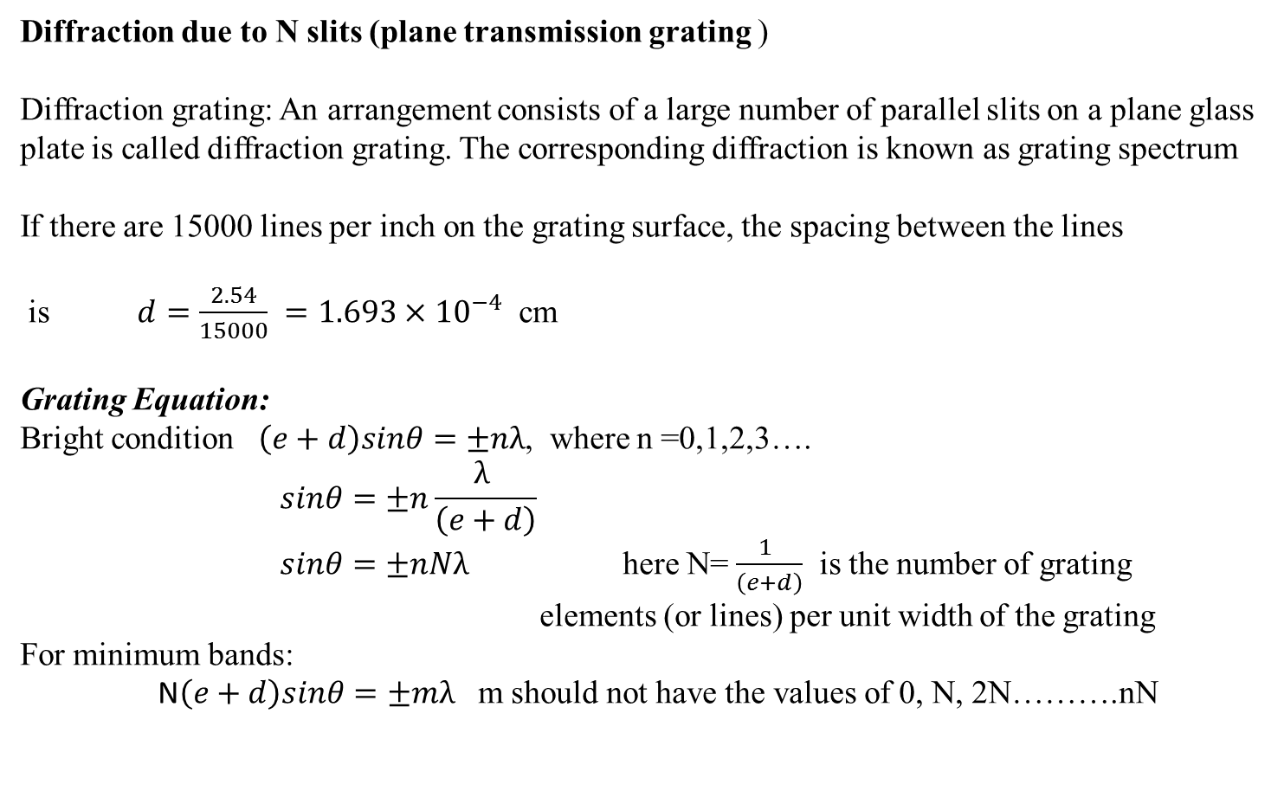
Diffraction due to N slits (plane transmission grating )
Diffraction grating: An arrangement consists of a large number of parallel slits on a plane glass plate is called diffraction grating. The corresponding diffraction is known as grating spectrum
If there are 15000 lines per inch on the grating surface, the spacing between the lines
is $d=\frac{2.54}{15000} =1.693×{10}^{−4}$ cm
Grating Equation:
Bright condition $\left(e+d\right)sinθ=±nλ$, where n =0,1,2,3….
$$sinθ=±n\frac{λ }{\left(e+d\right)}$$
$sinθ=±nNλ$ here N=$\frac{1 }{\left(e+d\right)}$ is the number of grating elements (or lines) per unit width of the grating
For minimum bands:
N$\left(e+d\right)sinθ=±mλ$ m should not have the values of 0, N, 2N……….nN

Slide 9
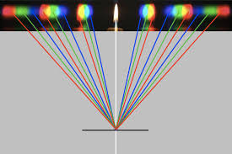
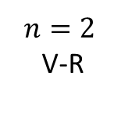
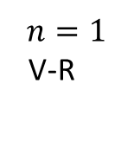
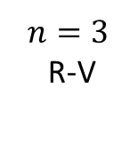
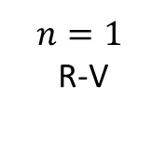
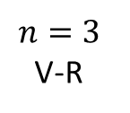
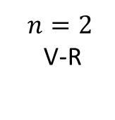
Grating Spectrum
$$n=3$$
R-V
$$n=2$$
V-R
$$n=1$$
R-V
$$n=1$$
V-R
$$n=2$$
V-R
$$n=3$$
V-R
Central maxima
n = order of the spectrum

Slide 10
Polarisation

Slide 11
Types of polarization
Double refraction
Nicols Prism
Quarter wave plate and Half wave plate

Slide 12
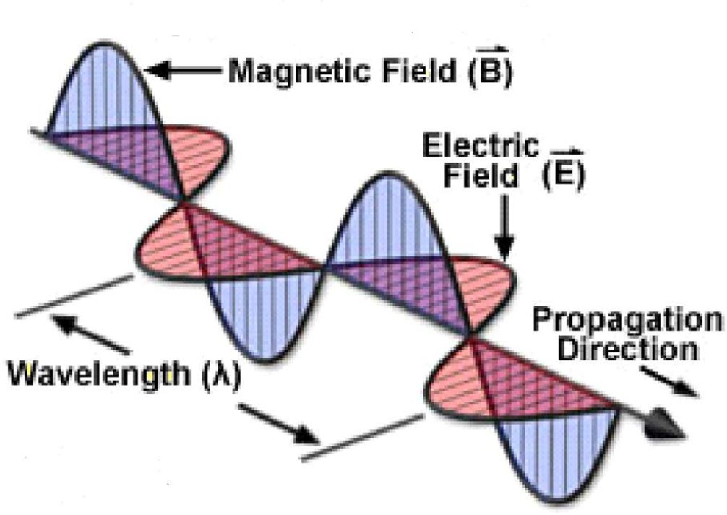
What is polarization?
Light is an electromagnetic wave, so both electric and magnetic fields associated with it. Both of this are vector quantities so they have a magnitude and direction
Polarization of the light is the direction of the electric field. It is always perpendicular to the direction of the light is travelling.
A light wave that is vibrating in more than one plane is referred to as unpolarized light.

Slide 13
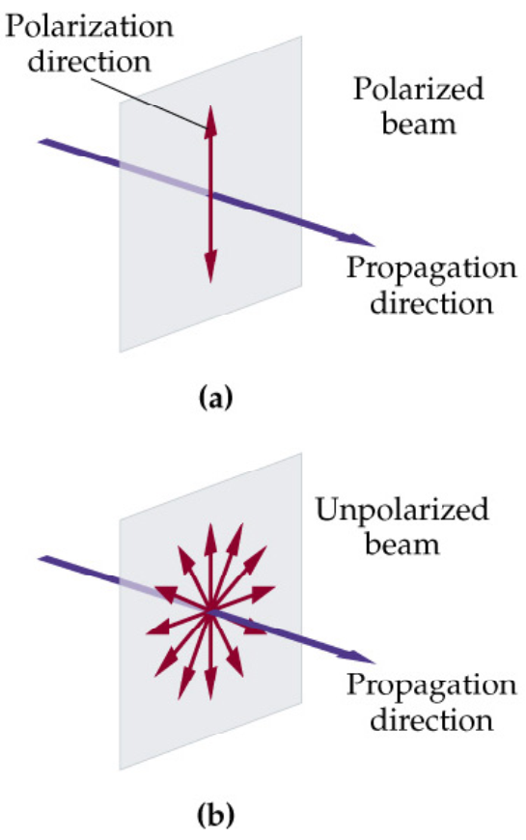
Types of polarization?
The process of transforming unpolarized light into polarized light is known as polarization of light.
E
E
Unpolarized
Polarized
Unpolarized
Polarized

Slide 14
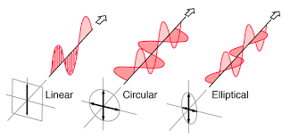
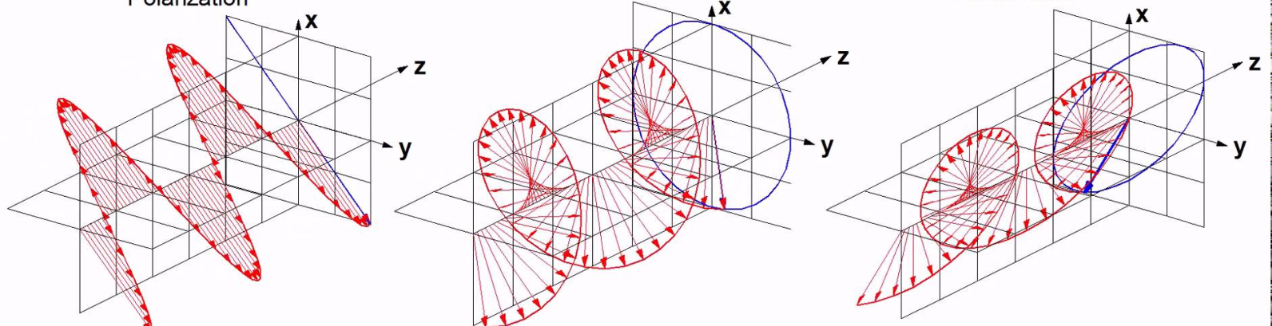
Types of polarization

Slide 15
Types of polarization
Linearly plane polarized light: If the vibrations of electric vectors are parallel and follows the same plane perpendicular to the direction of the propagation. The wave is said to be plane polarized
Circularly polarized light: Two coherent light waves of equal magnitude and perpendicular to each other superpose the magnitude of the resultant electric vector remains constant, This electric vector rotates about the direction of the propagation such that it goes on sweeping a circular helix.
Elliptically polarized light: Two coherent light waves of unequal magnitudes and difference in phase superpose, the magnitude of the resultant vector changes with time and this vector also rotates about the direction of propagation such that it traces an ellipse in the plane perpendicular to the direction of ray.

Slide 16
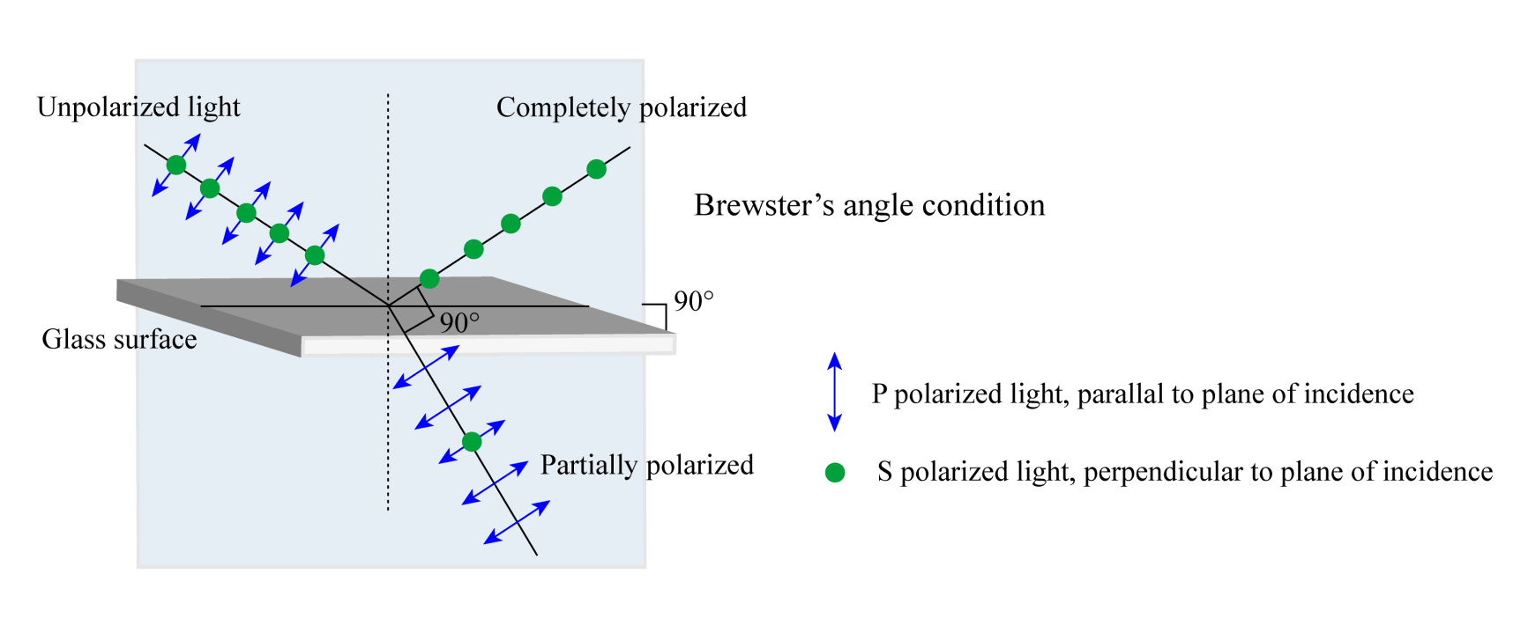



Brewster’s Law: Polarization by reflection
$$i_{p}$$
$$i_{p}$$
The tangent of angle of polarization is numerically equal to refractive index
$$\tan{i_{p}}=μ$$

Slide 17
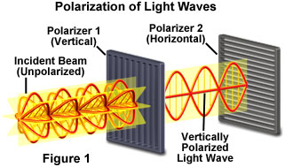
Polarization of Light

Slide 18
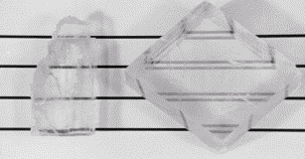
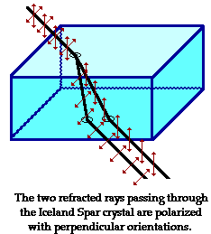
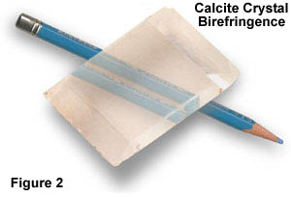
Crystal polarizers [birefringence]
isotropic
crystal
(sodium
chloride)
anisotropic
crystal
(calcite)
The 2 output beams are polarized (orthogonally).

Slide 19

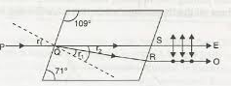
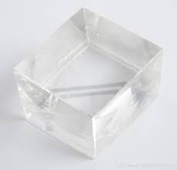
Double refraction (bifringence)
Optic axis
A
E
O
When a beam of ordinary light is passes through a transparent anisotropic crystal like calcite ,CaCO_{3,}or quartz. It splits into two refracted rays. This means that the material exhibits two different refractive indices.
Light passes through the crystal in a direction different from the optic axis. It is split in two rays; ordinary ray(o) and extraordinary ray.
O-ray and e-ray have different velocities with in the crystal accept at optic axis. At optic axis- both rays will have same velocities.
Eg: for sodium light λ =5893Ǻ refractive index of O-ray is 1.6584
E ray is 1.4864

Slide 20
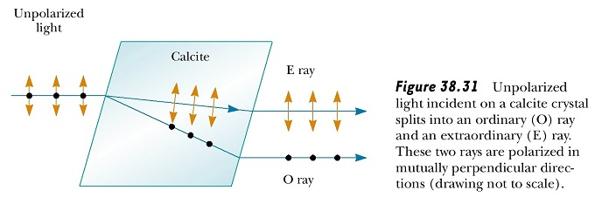
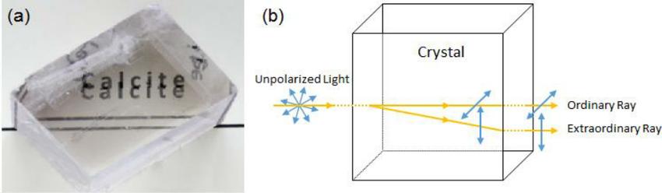
Double refraction

Slide 21
Nicols Prism
A Nicol prism is a type of polarizer. It is an optical device made from calcite crystal used to convert ordinary light into plane polarized light.
Construction:
The Nicol prism consists of two specially cut calcite prisms bonded together with an adhesive known as Canada balsam. This prism transmits waves vibrating in one direction only and thus produces a plane-polarized beam from ordinary light.
Optical axis, the straight line passing through the geometrical centre of a lens and joining the two centres of curvature of its surfaces. Sometimes the optical axis of a lens is called its principal axis. The path of a light ray along this axis is perpendicular to the surfaces and, as such, will be unchanged.

Slide 22
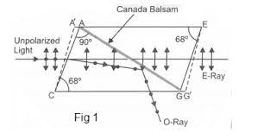

Slide 23
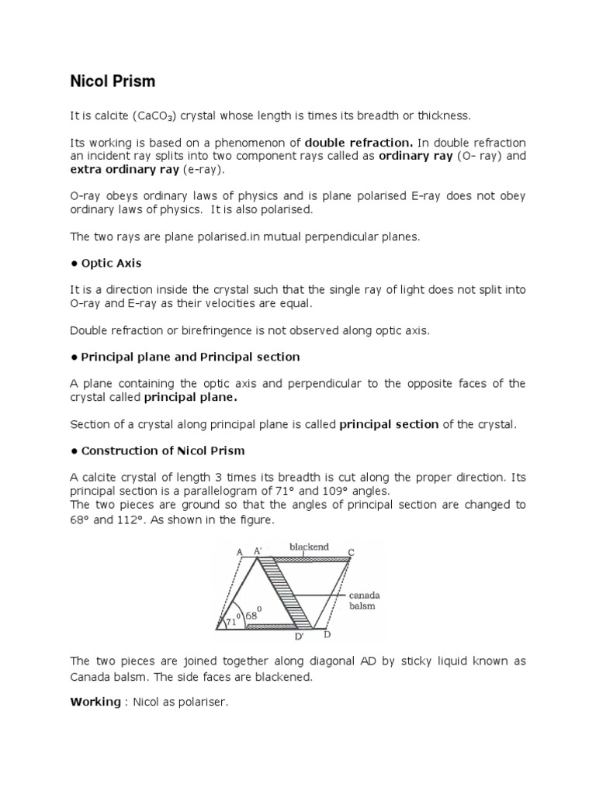

Slide 24

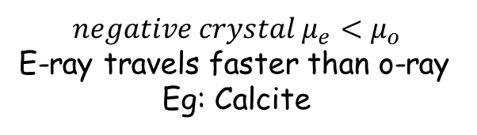

Quarter wave plate and Half wave plate
Optic axis
Optic axis
O-ray
E-ray
t
E-ray
t
O-ray
$${negative crystal μ}_{e}<μ_{o}$$
E-ray travels faster than o-ray
Eg: Calcite
$${positive crystal μ}_{e}>μ_{o}$$
O-ray travels faster than the e-ray
Eg: Quartz
The path difference between the o-ray and e rays is
$$∆ =\left({ μ}_{e}\sim μ_{o} \right)t$$

Slide 25
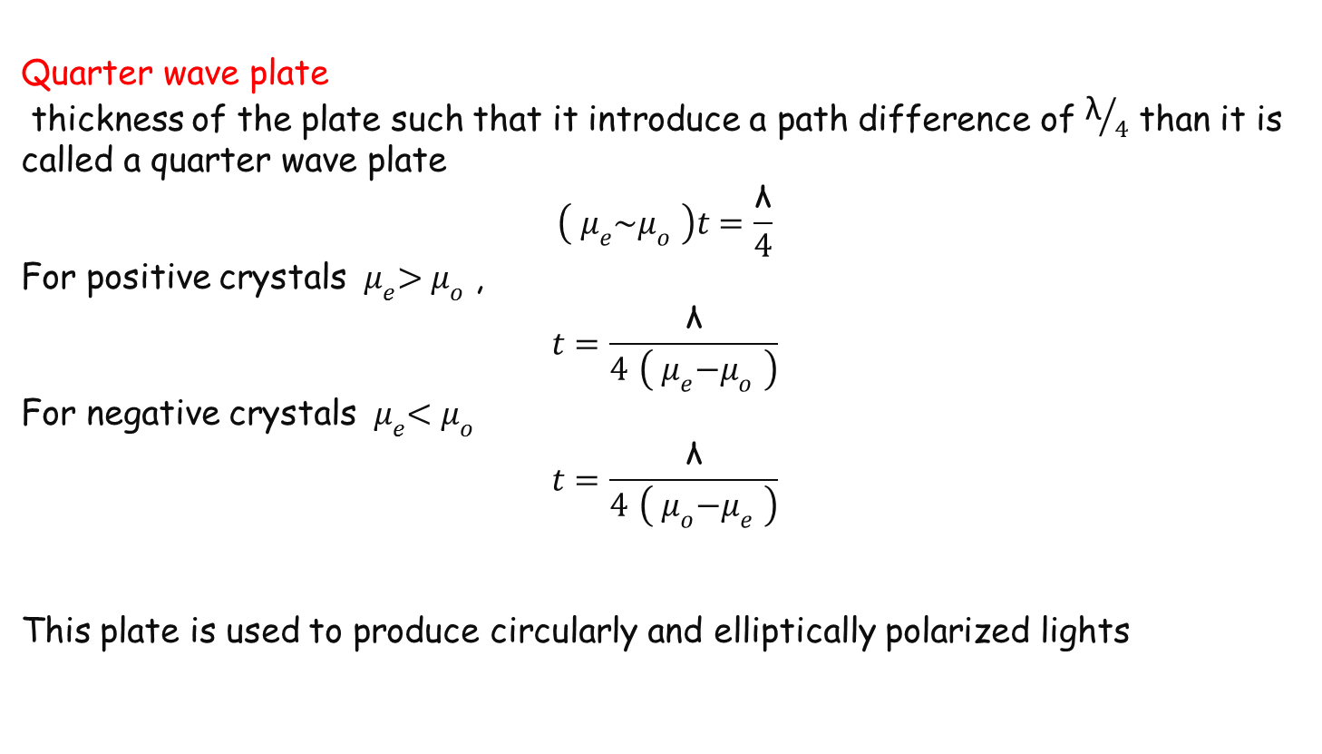
Quarter wave plate
thickness of the plate such that it introduce a path difference of ${\text{λ}}/4$ than it is called a quarter wave plate
$$\left({ μ}_{e}\sim μ_{o} \right)t=\frac{\text{λ}}{4}$$
For positive crystals ${ μ}_{e}>μ_{o}$ ,
$$t=\frac{\text{λ}}{4 \left({ μ}_{e}−μ_{o} \right)}$$
For negative crystals ${ μ}_{e}<μ_{o}$
$$t=\frac{\text{λ}}{4 \left({ μ}_{o}−μ_{e} \right)}$$
This plate is used to produce circularly and elliptically polarized lights

Slide 26
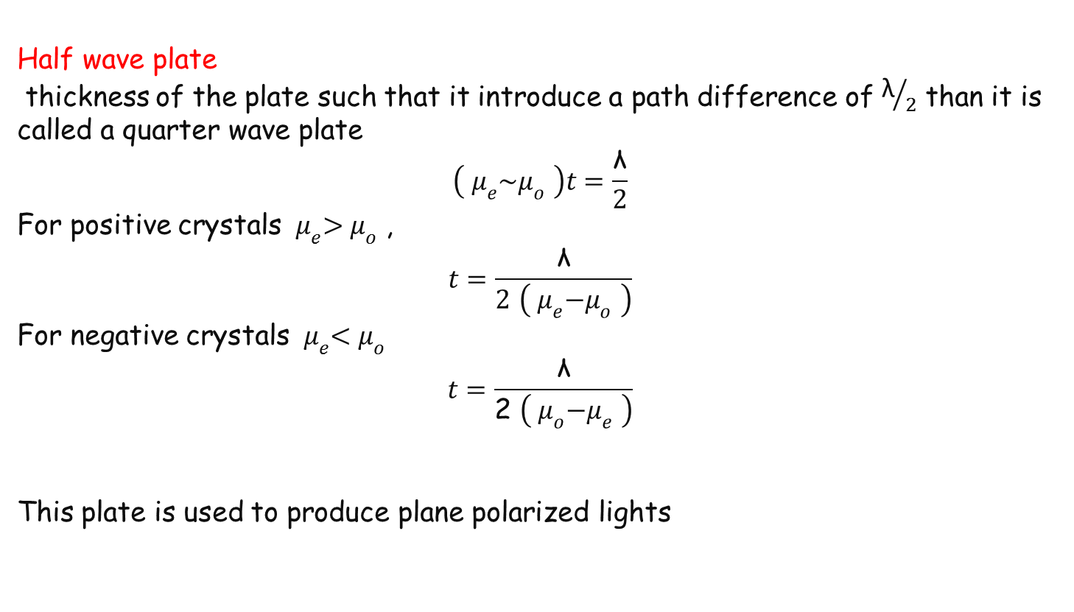
Half wave plate
thickness of the plate such that it introduce a path difference of ${\text{λ}}/2$ than it is called a quarter wave plate
$$\left({ μ}_{e}\sim μ_{o} \right)t=\frac{\text{λ}}{2}$$
For positive crystals ${ μ}_{e}>μ_{o}$ ,
$$t=\frac{\text{λ}}{2 \left({ μ}_{e}−μ_{o} \right)}$$
For negative crystals ${ μ}_{e}<μ_{o}$
$$t=\frac{\text{λ}}{\text{2} \left({ μ}_{o}−μ_{e} \right)}$$
This plate is used to produce plane polarized lights
Half

Slide 27
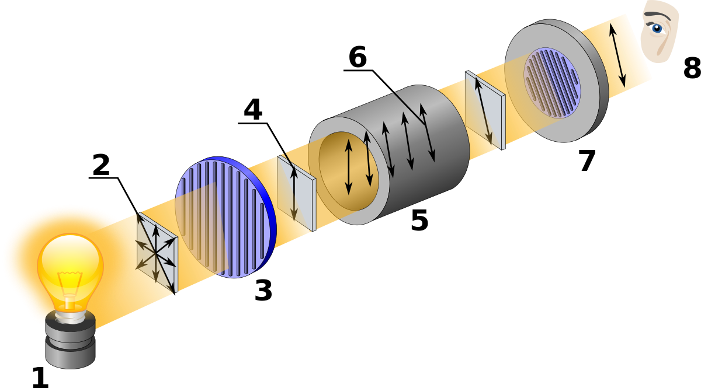
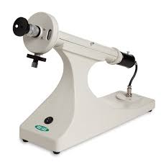
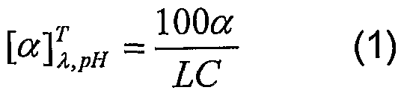
POLARIMETER
Specific rotation

Slide 28
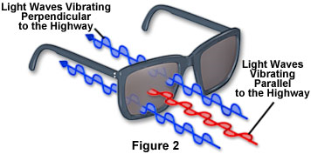
Applications of Polarization
Polarized Sunglasses
Reduce glare off the roads while driving

Slide 29

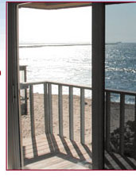
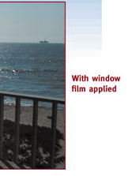

Slide 30
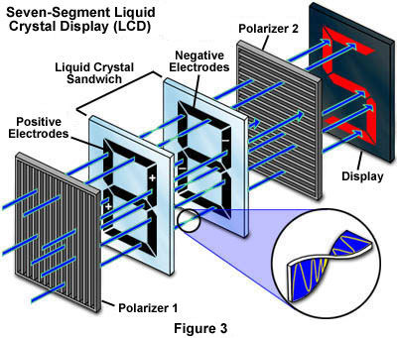
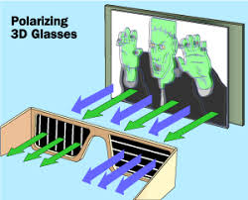
Applications of Polarization

Slide 31


